Slide 1
Chapter 6
Physics by HRK V1 5th Ed.
Topic nos. differ as the material is taken from an other book
By
Zuhoor Elahi

Slide 2
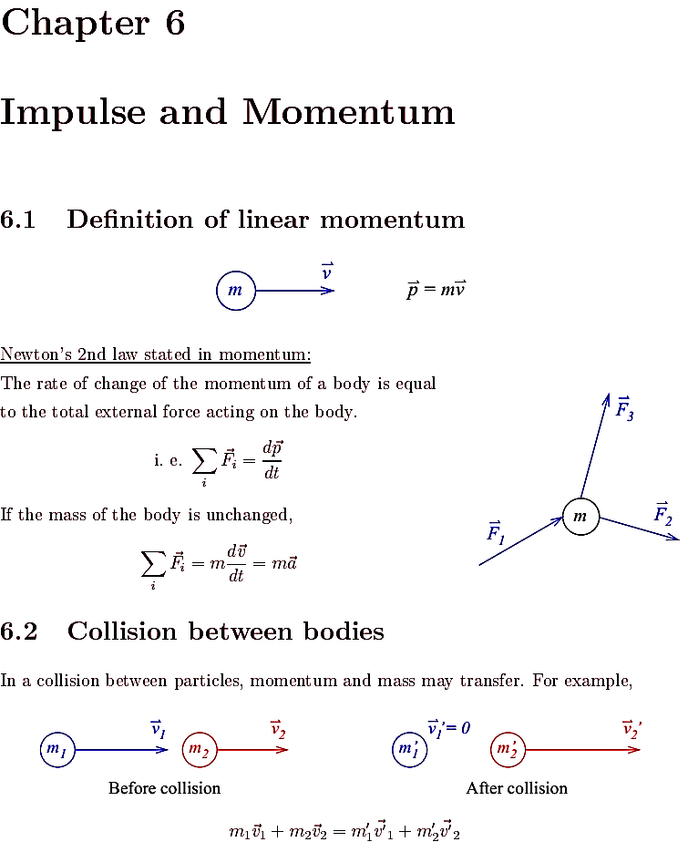

Slide 4
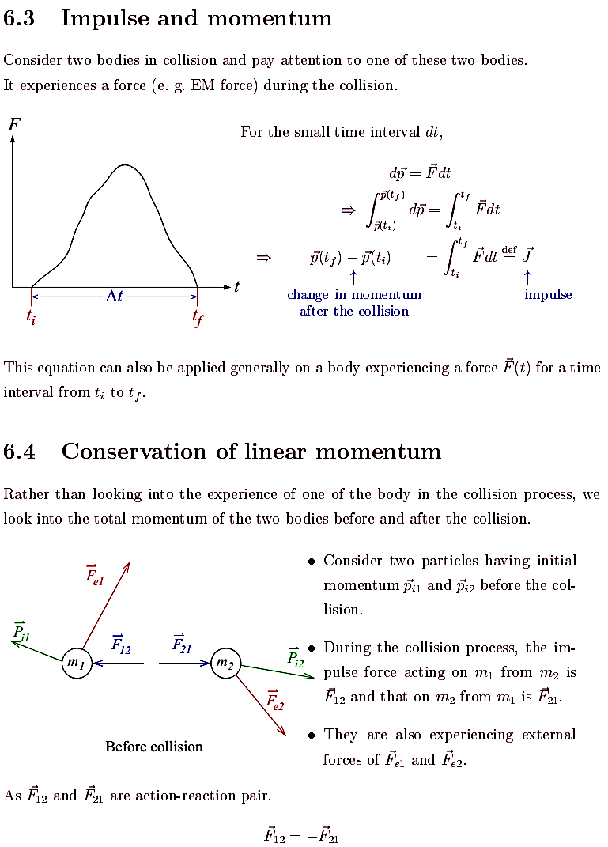

Slide 6
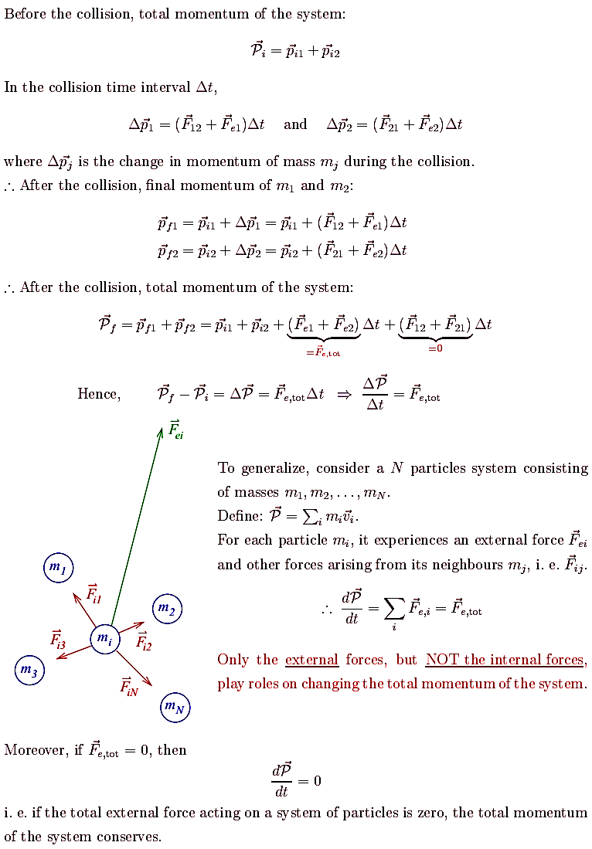

Slide 8
